Slide 1

Unemployment and Financial Crisis In Review
Data Engineering Platforms for Analytics
Aakash Pahuja, Adrienne Wang, Brandon Allen, Prasanth Chinta
June 12, 2020

Slide 2




Our Team
Aakash Pahuja
MScA Candidate at The University of Chicago
RFID Solution Architect
Adrienne Wang
MScA Candidate at The University of Chicago
Brandon Allen
MBA Candidate at The University of Chicago
Senior Associate Director of Analytics at The University of Chicago
Prasanth Chinta
MScA Candidate at The University of Chicago
Senior Product Manager at a Financial Firm

Slide 3
Table of Contents
TEAM 2
EXECUTIVE SUMMARY 4
BUSINESS CASE 5
DATA SOURCES AND TOOLS 6
DATA PROFILE 7-11
EER DIAGRAM 12
PROCESS 13-18
ANALYSIS 19-24
RESULTS 25
FUTURE DIRECTIONS 26
DESIGN CONSIDERATIONS 27
LESSONS LEARNED 29

Slide 4

Does history repeat itself?
Extrapolating implications from the 2008 Financial Crisis for a COVID-19 world.
The 2008 Financial Crisis was one of the most severe global economic crises in history. Its impact was felt across all industries, and it continues to have a material impact on countless lives. Learning from the past could allow policy-makers, civic leaders, and industry entities to more adequately prepare for future economic recessions.
By understanding how the 2008 crisis impacted employment and stock performance, we seek to identify individuals and industries that are most vulnerable to economic downturns. In doing so, we hope to highlight opportunities for support during the next economic crisis.

Slide 5
Business Case
Demographic Analysis
Stock Market Analysis
Employment Analysis
Objective
Financial Crisis Analysis
Develop analytics framework to carry out the analysis of the Financial Crisis on unemployment rate
Detail impact on stock market and workforce deployment
Identify individuals’ characteristics and industries that are most at-risk
Design One-Page Dashboard to interactively visualize current and historical KPI, filtered by selected dimensions
Data Structure Design
Underlying Data Structure Design
Data Source Clarification
Verification
Result Verification

Slide 6








Data Engineering Tools
Data Collection
Data Processing
Data Warehouse
Data Visualization
Web-scraping
Public APIs
.csv Downloads
Notes:
Thank you, Adrienne. Good evening. Let me start with the tools we used in this project.
We used web scraping, APIs connections, and in one case downloaded CSV file. We had to web-scrap the Sector/Industry stocks performance data using Jupyter notebook. This process is automated such that we can implement simplar steps to get the data periodically.
Labor Statistics data is aviable via APIs. These are public APIs, but we registered so that we can extract large number of data codes at a time. Again this step is automated using Jupyter Notebook.
In case of getting index peformance data, we had to download csv files due to non-availability of the APIs.
We used Python and R to process our data and improve data quality. We made sure to remove nulls, make sure datetime information is not duplicated. Finally the data is loaded into a staging table.
We used MySQL on Google Cloud Platoform and ran schema and data queries to create a dimensional tables. Finally we have implemented the above on NoSQL to see the viablity, which was successful.
Finally we used Tableau to develop our visuals.
Now let’s check our datasets.

Slide 7
Our Datasets
Data Profile | Description | Total Size | Sources # | # of Rows | Columns # | Structure | Source
Stock Market Indexes | S&P 500, Dow Jones IA, and NASDAQ Indexes | 16KB | 1 | 149 | 4 | Structured | Yahoo Finance
Employment and Labor Force Participation Data for Education Attainment | Labor force, employment, and unemployment statistics by educational attainment for persons age 25 and older | 22KB | 1 | 360 | 2 | Structured | Bls.gov Website and Public API FRED
Currency Exchange Rate | US to EURO Currency Exchange Rate | 10KB | 1 | 149 | 5 | Structured | FRED
Unemployment Duration | Unemployment Duration | 64KB | 1 | 588 | 5 | Structured | Bls.gov Website and Public API
Unemployment Rate and Volume by Demographics | Unemployed jobseekers by sex, reason for unemployment, and active job search methods used | 193KB | 1 | 5,000 | 6 | Structured (JSON) | Bls.gov Website and Public API
Stocks Return by Industries | Annual returns for the ten stock market sectors against the S&P 500 | 112KB | 1 | 1872 | 5 | Structured | Novel Investor
Notes:
Our data very concrete. Since our business case is understanding the relation/impact between broader market performance with labor market during the time crisis, we have narrowed our datasets. We acquired the data from Yahoo Finance, Fed Reserve, and Labor Department.
Let me briefly explain the data quality steps we took.

Slide 8

Data Quality
Completeness
There are no missing values in our datasets as we ensured that ETL process has necessary checkups
Validity
Our data passes format check, length check, lookup table, presence check, range check and spell check
Uniqueness
Our datasets have duplicated monthly data to keep all datasets at the same granularity level (No interference with analysis)
Consistency
Data format is consistent across all tables
Timeliness
Our data except industry returns is up to date (May 2020)
Accuracy
Accuracy is verified by our data providers
Notes:
Let me talk about data profiles.

Slide 9
Data Profile After
● dim_master_codes: “Data about races, education, marital status etc.”
57 rows and 9 columns
Columns:
stg_id smallint(5) UN AI PK
code varchar(45)
sexes varchar(4)
races varchar(10)
age varchar(10)
education varchar(255)
marital_status varchar(45)
bls_type varchar(45)
ts timestamp
Notes:
We implemented a master code table. It is has demographic and necessary codes to pull the data from the APIs.
The information is curated so that it can be impleted further into data dictionary.
Next table is period table

Slide 10
Data Profile After
● dim_period: “data about month, year”
156 rows and 4 columns
Columns:
period_id smallint(6) PK
period_month varchar(45)
period_month_number varchar(40)
period_year year(4)
● fact_econ_data: “Data type about Dow_Jones_Average_Close, Nasdaq_Average_Close, SP500_Average_Close, employment ratio and rate, unemployment ratio and rate”
6435 rows and 6 columns
Columns:
bls_id smallint(5) UN AI PK
period_id smallint(6)
bls_type_id smallint(6) UN
bls_value decimal(10,2)
last_update timestamp
Notes:
Since our business case is understanding between two different crisis, the importance lies in the time series. So we have implemented a dimentional table for time.
Next our important information is the fact table. Our measure is index values, stock performance, and unemployment/employment data.
Next Code table.

Slide 11
Data Profile After
● industry_returnRate_bridge: “Industry name being affected in the financial crisis”
12 rows and 2 columns
Columns:
-industry_id int(11) AI PK
-industry_name varchar(45)
● t_backup_bls_Unemployed_data:
5297 rows and 7 columns
Columns:
-stg_id smallint(5) UN AI PK
-year varchar(45)
-period varchar(45)
-periodName varchar(45)
-latest varchar(10)
-value double
-footnotes varchar(45)
-seriesID varchar(45)
-ts timestamp
Notes:
We two major staging table to collect the data.

Slide 12
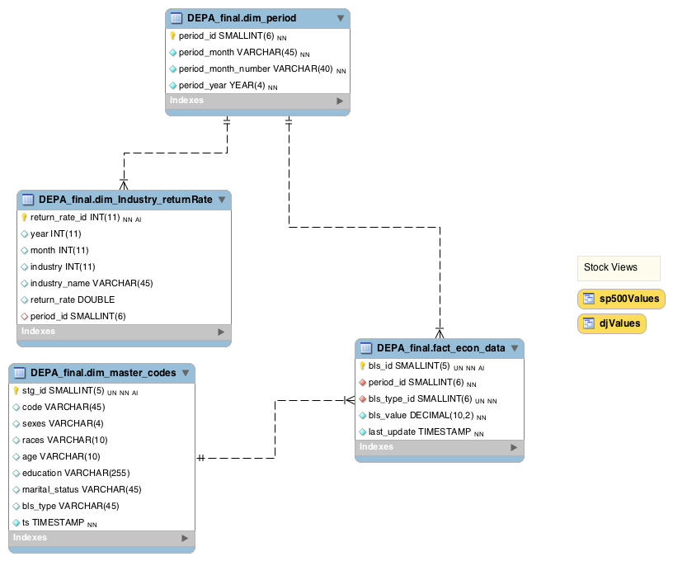
Our Snowflake Dimensional Table
Notes:
Here’s our snowflake model. We have also implemented few views to pull necessary data for tableau.
Next, Aakash will provide the steps we implemented starting with Data Ingestion.

Slide 13

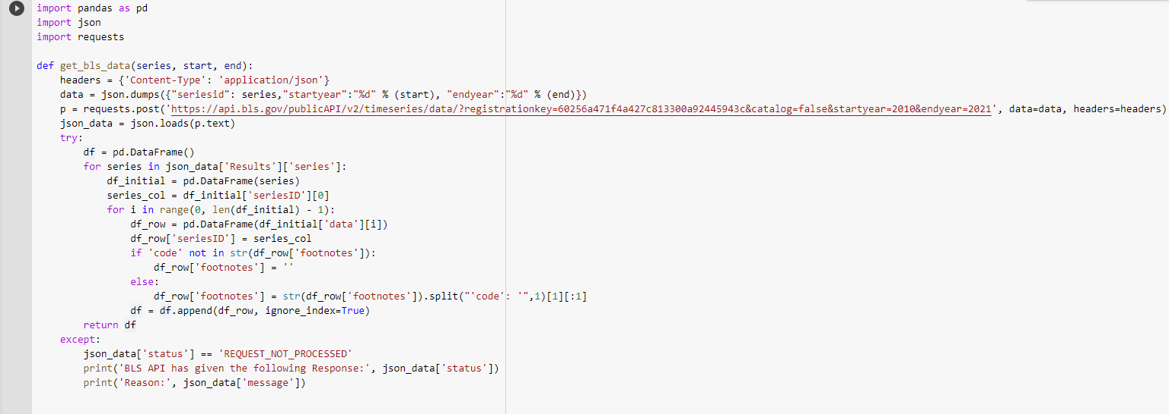
Data Ingestion
We are connected to the bls api to gather information for:
unemployment_duration
unemployment_rate and employment_rate
consumer price index

Slide 14

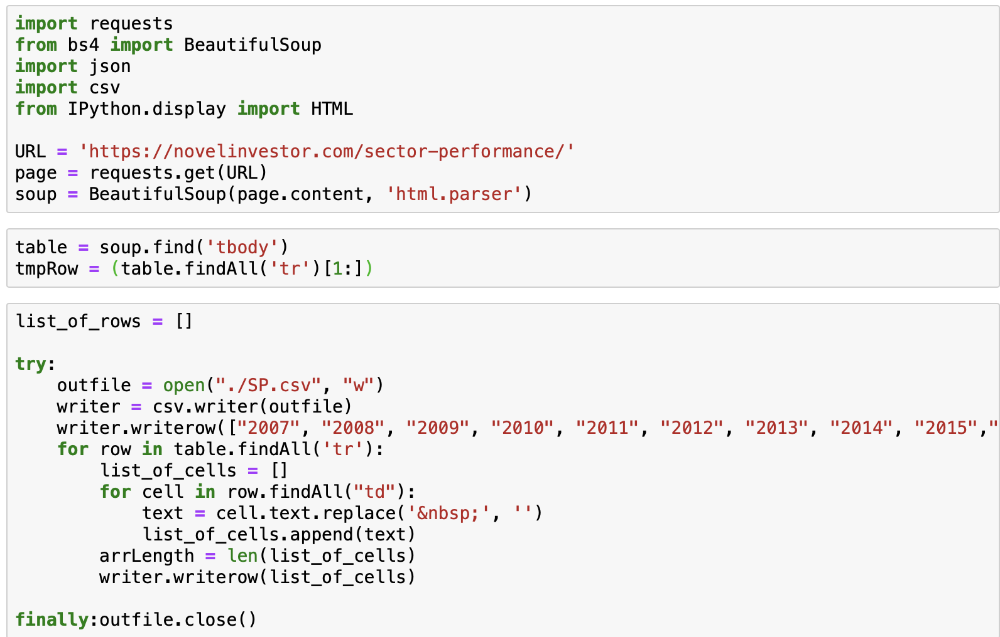
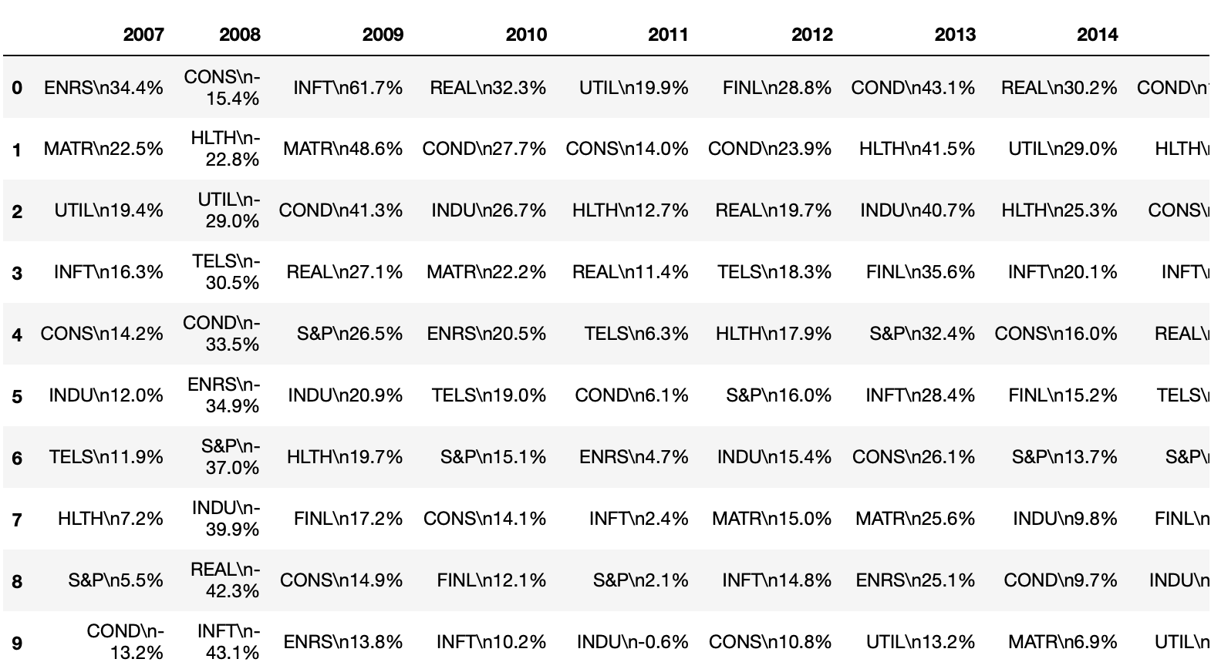
Data Ingestion Example
Tool Utilized
Jupyter Notebook (package csv, and BeautifulSoup to open and scrape web data and write to CSV)
Web Scraping Code
Output
Notes:
Link for jupyter icon: https://teradata.github.io/jupyterextensions/assets/icons/jupyter.logo.png

Slide 15
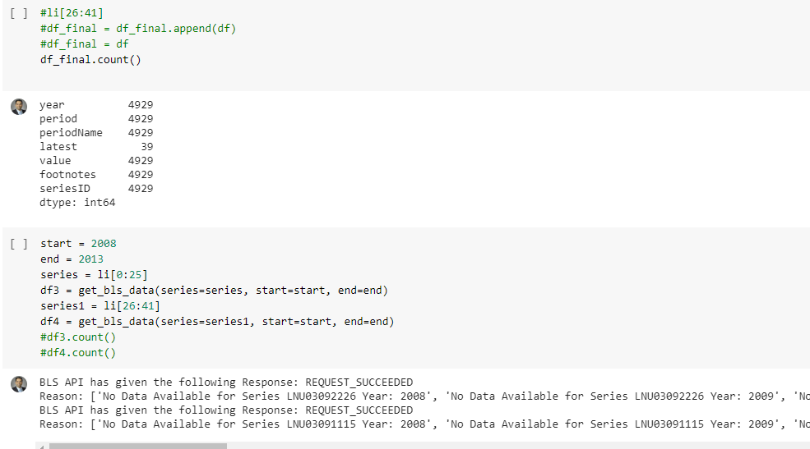
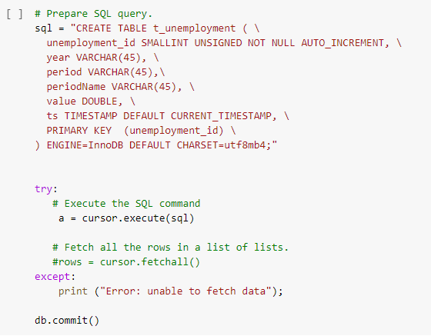
Data Cleaning
Api Data cleaned using python packages like prettytable in Jupyter notebook
Using pymysql to do DDL and DML in MySQL.
API Code Snip
Add snip below

Slide 16
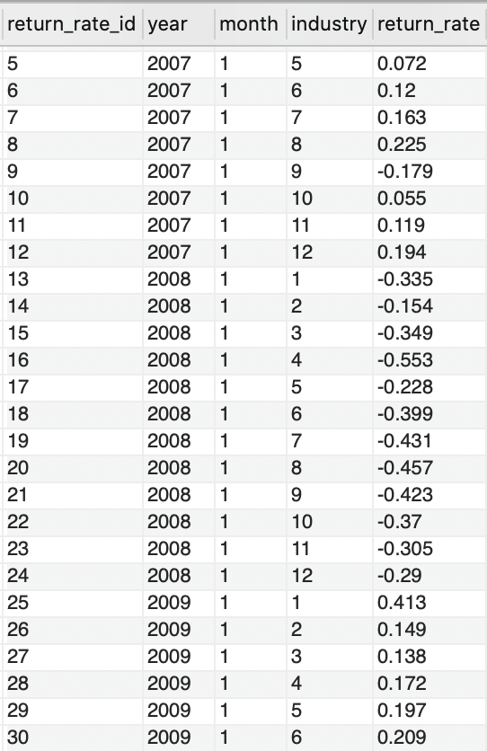

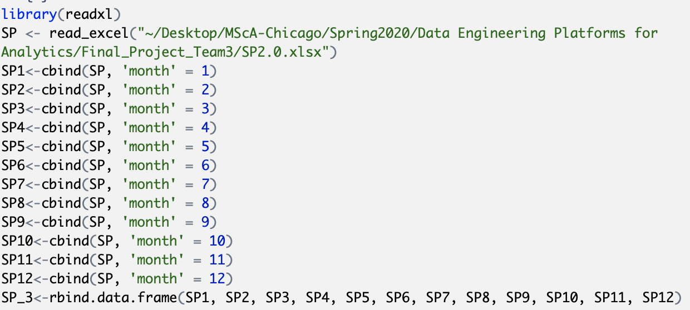
Data Cleaning Example
Output
R Code
R Studio was used to replicate yearly data as monthly data

Slide 17
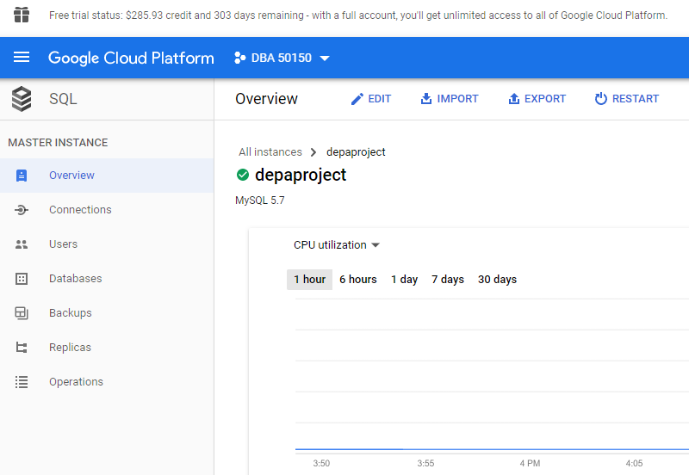
Data Warehouse through GCP
Storage is fast with uncapped bandwidth with strongly consistent listings.
With numerous data breaches and security issues reported in the news almost daily, security is on top of our mind. Hence, GCP offers robust data privacy and security features.
Fully compatible with Jupyter notebook, MySQL, and Tableau with convenient data transfer mechanism.

Slide 18
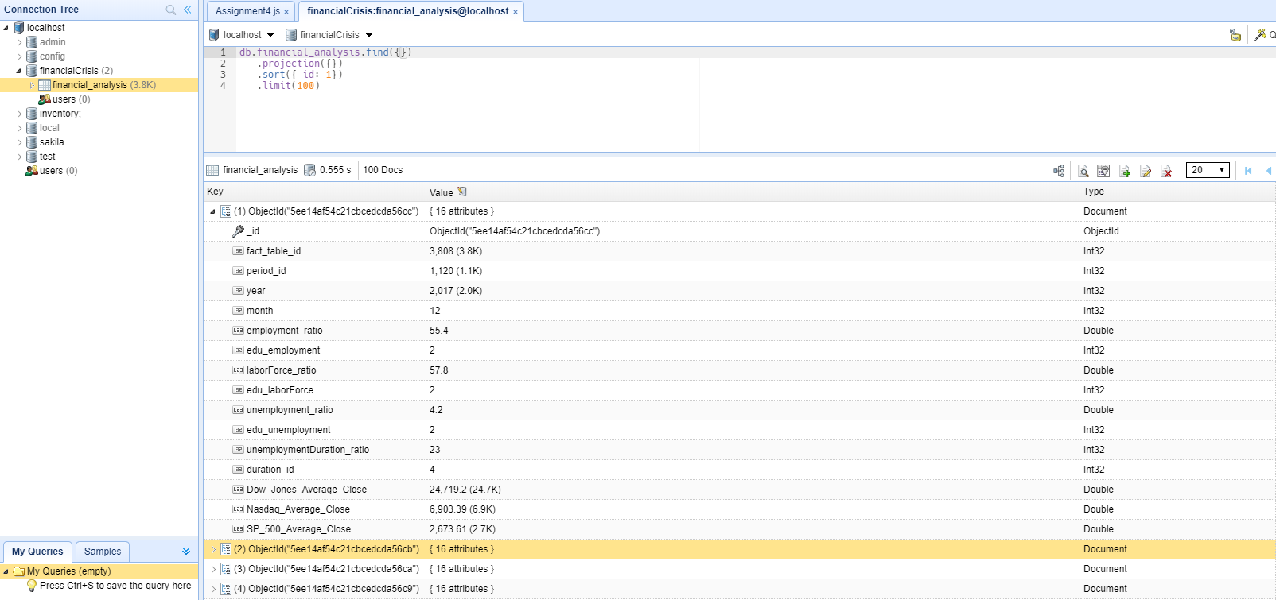
NoSQL DATABASE
MongoDB is document database, which fits well with our data, as each document contains several attributes (Dow_Jones_Average_Close, Nasdaq_Average_Close, SP_500_Average_Close, employment_ratio, unemployment ratio etc.) for each specific month and year.

Slide 19
Why MongoDB over Neo4j for OLTP?
- We used MongoDB over Neo4js because the analysis we needed was been done using MongoDB. If government officials wanted to add new data for a particular month and year, they could do that easily by just creating a new document in Mongo
- Different categorical variables are only linked through a rate number. Graphical database can only provide minimal insights to future use cases
- Our business case focuses on trend analysis mainly and relational graph provides minimal insight to our use case

Slide 20
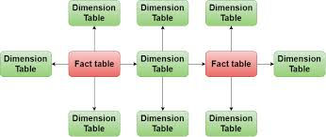
Design Considerations
Outliers, Anomalies, and Aggregation
We didn’t encounter outliers or anomalous data points, but we were prepared to treat them if necessary
Aggregated by time period depending on the native time scale to ensure consistent granularity of time
Data Transformations
Melted and reformed dim tables to better integrate with fact table
Reshaped industry data to successfully visualize in Tableau
Aligned education codes across BLS and Fred datasets
Standardized period naming conventions
Data Mapping
We considered a galaxy schema, but decided for the purposes of this project to go with snowflake

Slide 21
After creating reports and building dashboards in Tableau, we noticed that ...

Slide 22
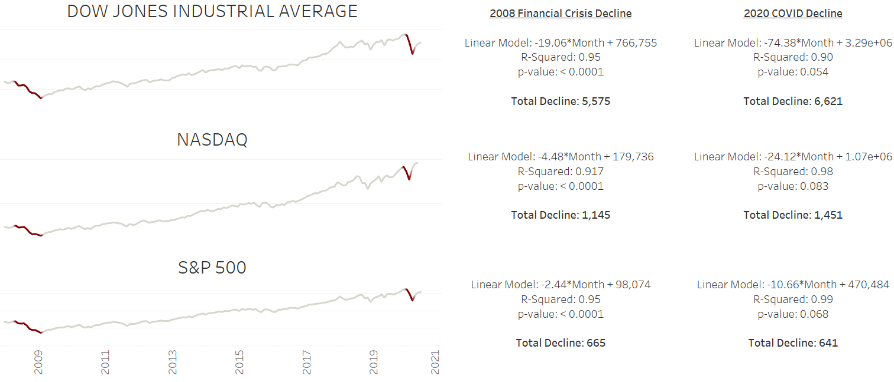
The decline in stock index performance during the 2008 Financial Crisis is sufficiently similar to the 2020 COVID decline

Slide 23
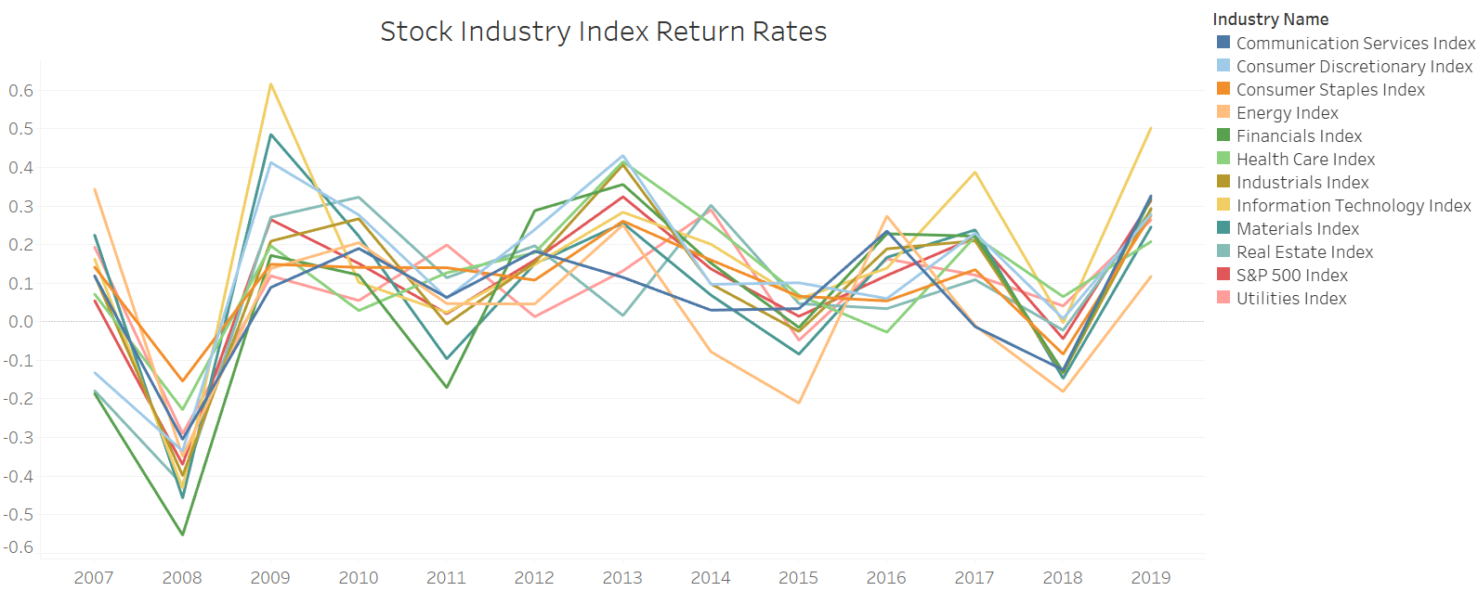
Stock industry indexes behaved similarly with a steep decline in 2008
Note: this data captures 2007 to 2019

Slide 24
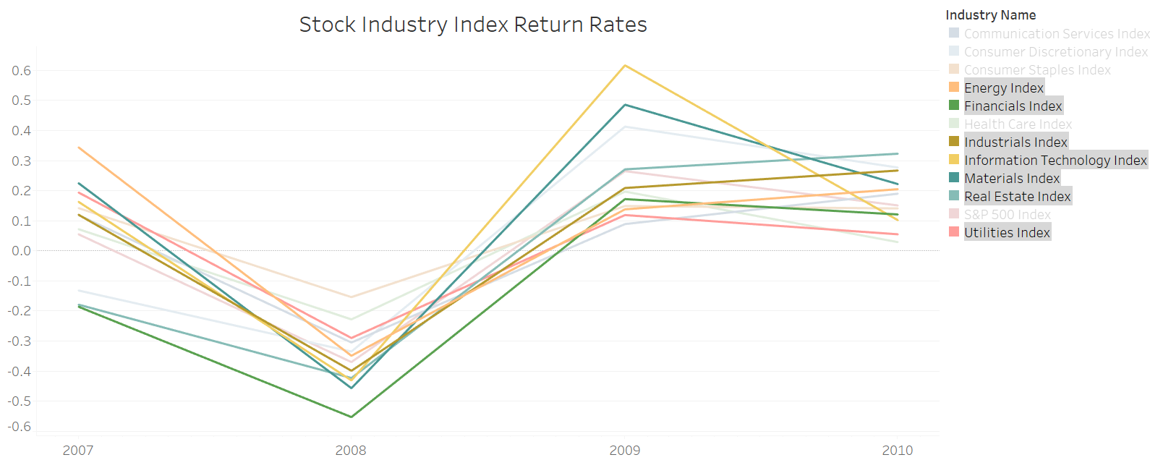
The Energy, Financials, Industrials, Information Technology, Materials, and Real Estate industries had the lowest average return rates during 2008
Energy and Utilities didn’t recover until 2010

Slide 25
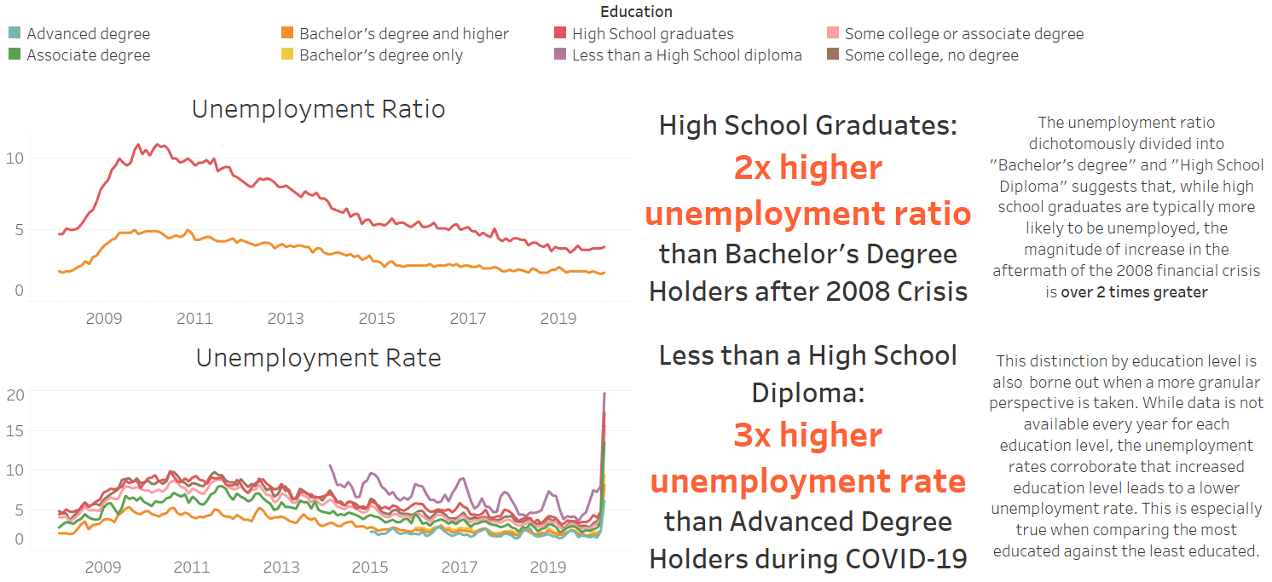
Lower education attainment suggests greater risk for unemployment, especially during financial crises
Comparisons across other metrics (Labor Force Participation, Consumer Price Index, etc.) and demographics (gender, etc.) did not yield meaningful differences

Slide 26
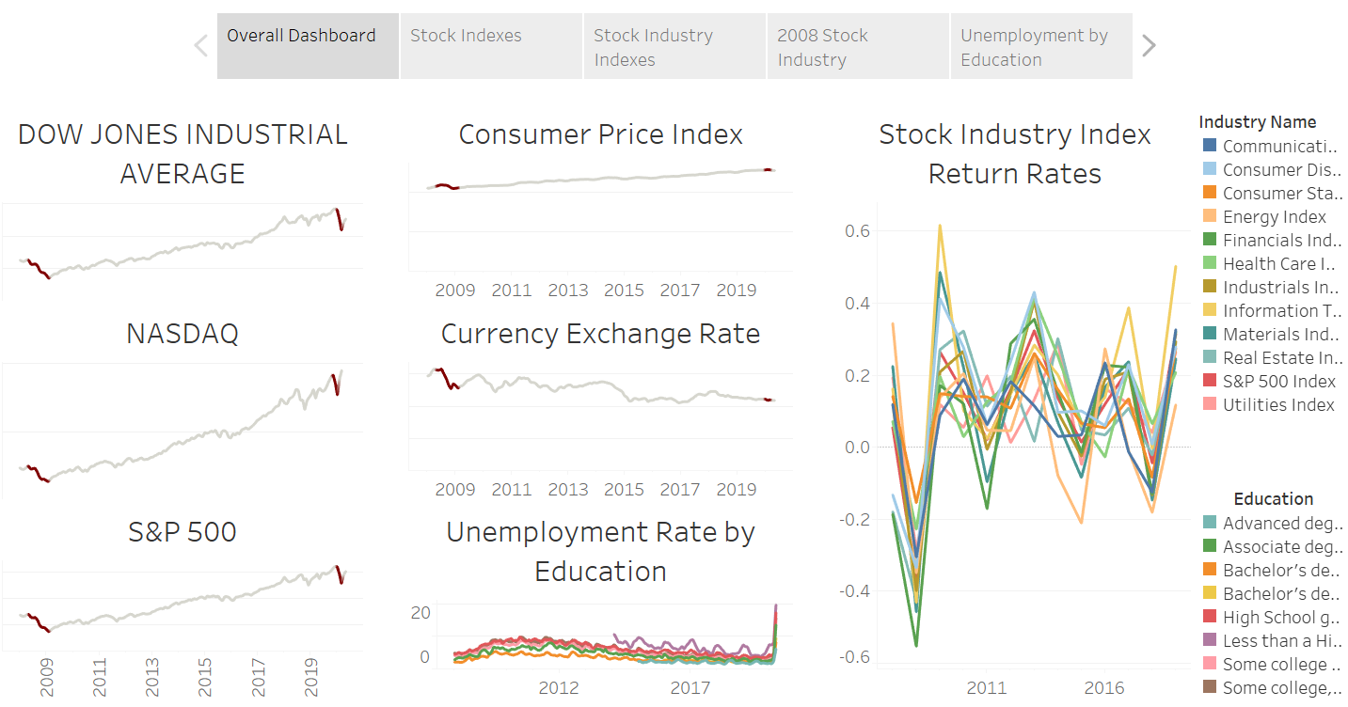
Our Tableau dashboard consolidates sheets for future research

Slide 27
FUTURE DIRECTIONS

Slide 28
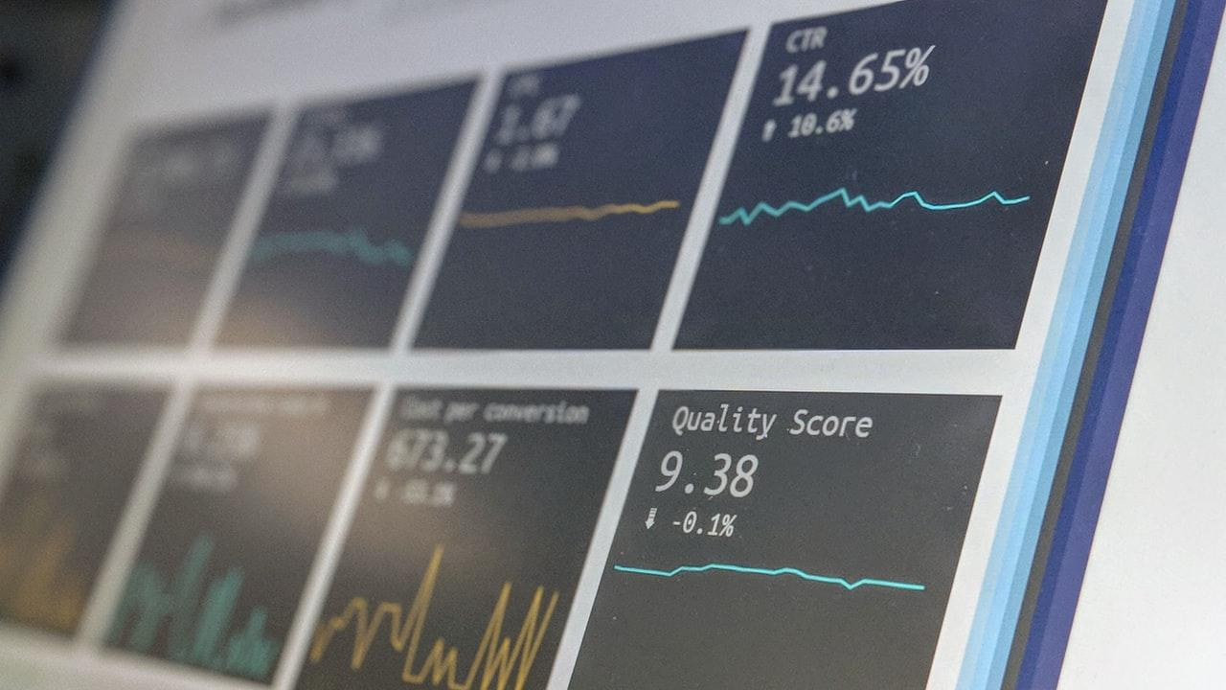
The Energy, Financials, Industrials, Information Technology, Materials, Real Estate, and Utilities industries
The least educated members of society (less than a bachelor’s degree)
Industry and civic leaders must prepare
dropped to the lowest absolute return rate during the 2008 Financial Crisis
are most at-risk of becoming unemployed during a financial crisis
to implement programs that quickly and efficiently support these most vulnerable individuals and industries to mitigate long-term fiscal damage

Slide 29
Lessons Learned
Schema Selection
Most datasets have only rate and date columns (Snowflake over Galaxy)
Ideal for our business case: compare trends for multiple indexes together
Time dimension is extremely important
Data quality
It was extremely helpful to have identified and leveraged high-quality and well-documented data sources
Data availability
Finding the right data can be challenging, especially when attempting to avoid paywalls
Adding more data could yield additional insights
Structural decisions
Developing the schema requires tremendous vetting and iterative review to deliver best results

Slide 30
Thanks!

